Slide 1
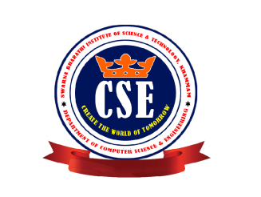


MINI PROJECT REVIEW
ON
IMAGE STEGANOGRAPHY
Presented By:
CH.SAI SHARANYYA - 16M61A0511
CH.SRAVANTHI - 16M61A0514
R.V RAMA DEVI - 16M61A0540
SK.HASEENA - 16M61A0546
Branch : CSE
Batch : 3
Year : 4-1
Under the guidance of :
Mrs.Y.Lakshmi Prasanna M.Tech
Associate Professor
Department of Computer Science & Engineering
Swarna Bharathi Institute of Science & Technology Academic year 2019-20

Slide 2
CONTENTS
ALGORITHM DESCRIPTION
SYSTEM DESIGN
SCREENSHOTS
CONCLUSION
FUTURE WORK
REFERENCE
INTRODUCTION
TYPES OF STEGANOGRAPHY
LITERATURE SURVEY
EXISTING SYSTEM
PROPOSED SYSTEM
SYSTEM REQUIREMENTS
SYSTEM ARCHITECHTURE
MODULES
TECHNOLOGY DESCRIPTION

Slide 3
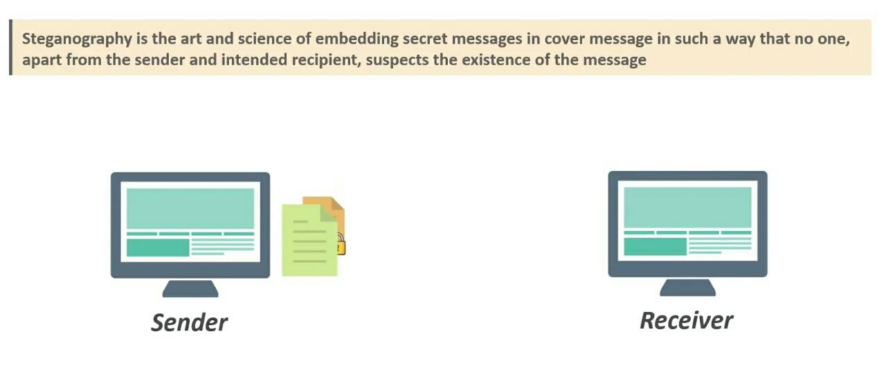
INTRODUCTION
Secret message
Cover Image

Slide 4
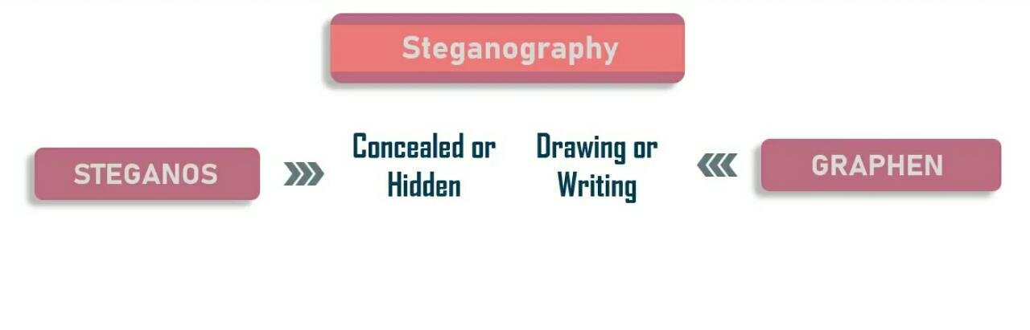
Steganalysis:
Steganalysis is the study of detecting messages hidden using steganography

Slide 5
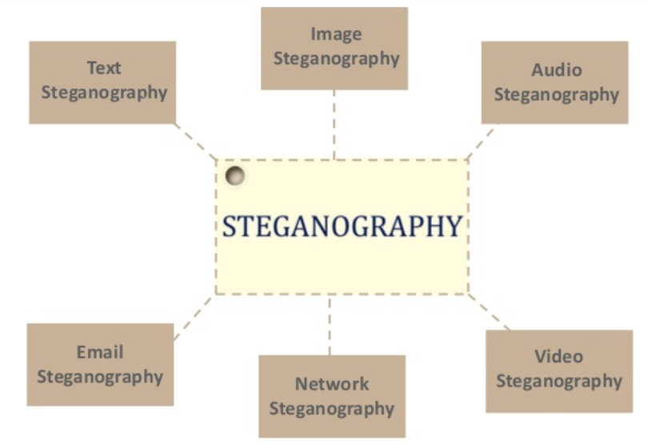
TYPES OF STEGANOGRAPHY

Slide 6
LITERATURE SURVEY
In [1], A. Joseph Raphael introduces basic terminologies of cryptography and steganography and ensures that the combination of both will provide better security.
In [2], Dr. R. Sridevi, Vijaya Lakshmi Paruchuri, K. S Sadasiva Rao proposed the method of embedding the secret message into an image using LSB technique and then it is encrypted by AES algorithm for better security.
In [3], Mehdi Hussain, Mureed Hussain proposed various technologies which is used in image steganography.
In [4],Lokesh Kumar introduced the concept of encrypting the secret Message using AES and Alteration component technique is used to hide encrypted secret message into cover image

Slide 7
EXISITING SYSTEM
However, we find that in most existing approaches, people often use cryptographic techniques to encode the data.
But cryptographic techniques will only hide the meaning of the data, but not the existence of data.
This cryptographic technique will be vulnerable to brute force attack.

Slide 8
PROPOSED SYSTEM
In this project we proposed an image based steganography that uses Least Significant Bits (LSB) technique which is most popular method on images to enhance the security of the communication.
In the LSB approach, the basic idea is to replace the Least Significant Bits (LSB) of the cover image with the Bits of the messages to be hidden without destroying the property of the cover image significantly.

Slide 9
ADVANTAGES
Steganography prevents discovery of existence of message.
Difficult to detect but only receiver can detect.
No body apart from sender and receiver can retrieve message.
Mainly used in Intelligence Bureau.

Slide 10
SYSTEM REQUIREMENTS
Hardware Requirements:
• System : Pentium IV 2.4GHz.
• Hard Disk : 4GB.
• Floppy Drive : 1.44MB.
• Monitor : 15 VGAColour.
• Mouse :Logitech.
• RAM : 256MB.
Software Requirements:
• Operating system : – Windows XP Professional.
• Front End : – Visual Studio.Net2005
• Coding Language : –python

Slide 11

Hjjhb
SYSTEM ARCHITECTURE
Secret message
Cover image
Stego image
Encoder
Secret message
Decoder
Communication
channel

Slide 12
MODULE DESCRIPTION
Steg module: In this module user need to write any secret information in
text area provided and need to select an image file to which user wants to
append the secret information text.
Unsteg module: In this module the encrypted image will be selected and
stegnography application will start decrypting it with each and every pixel of the image and displays the output i.e., secret text information.

Slide 13
TECHNOLOGY DESCRIPTION
We used some of the technology for the image steganography they are:
Python
It is an open source programming language that was made to be easy-to-read and powerful. A Dutch programmer named Guido van Rossum made Python in 1991.
He named it after the television show Monty Python's Flying Circus. Many Python examples and tutorials include jokes from the show.
Python is an interpreted language. Interpreted languages do not need to be compiled to run. A program called an interpreter runs Python code on almost any kind of computer. This means that a programmer can change the code and quickly see the results. This also means Python is slower than a compiled language like C, because it is not running machine code directly.

Slide 14
ALGORITHM DESCRIPTION
LSB Algorithm:
• LSB means least significant bit.
• The most common and popular method of modern day steganography is to make use of LSB of picture's pixel information.
• This technique works best when the file is longer than the message file and if image is grey scale.
• When applying LSB techniques to each byte of a 24 bit image ,three bits can be encoded into each pixel.

Slide 15
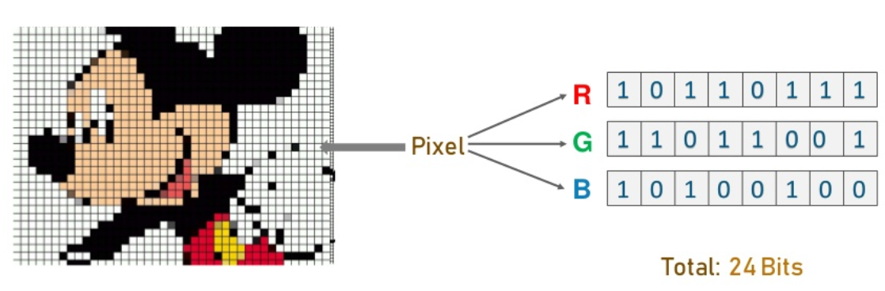
ALGORITHM

Slide 16
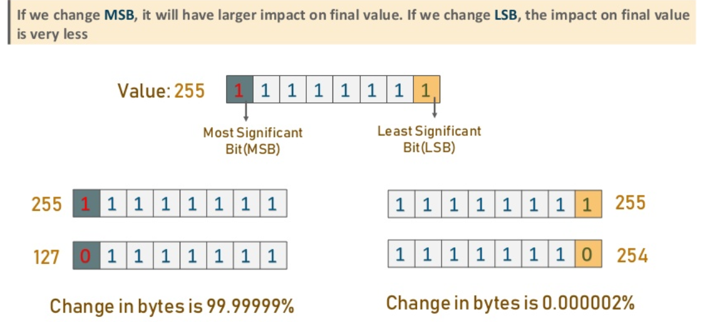

Slide 17
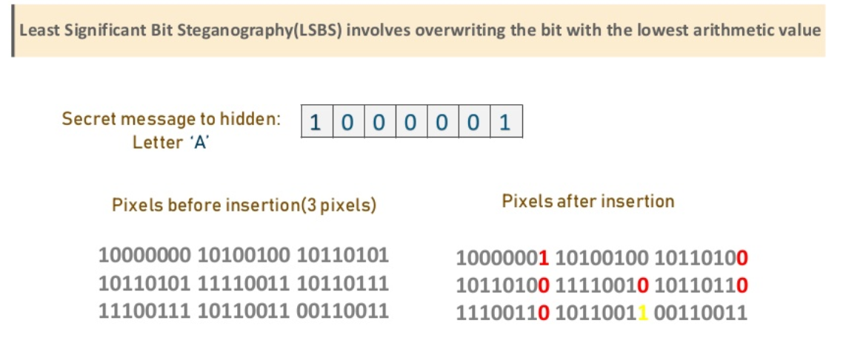

Slide 18
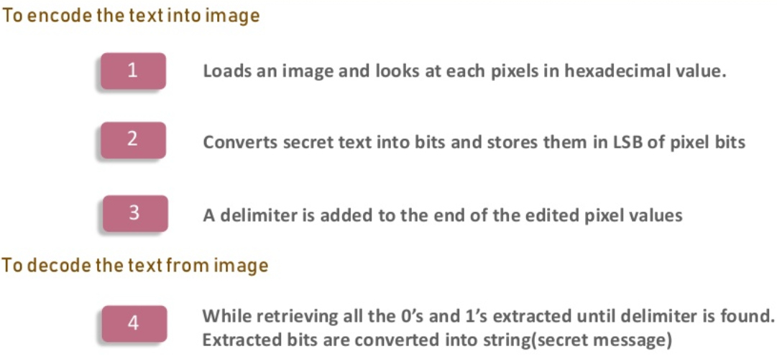

Slide 19
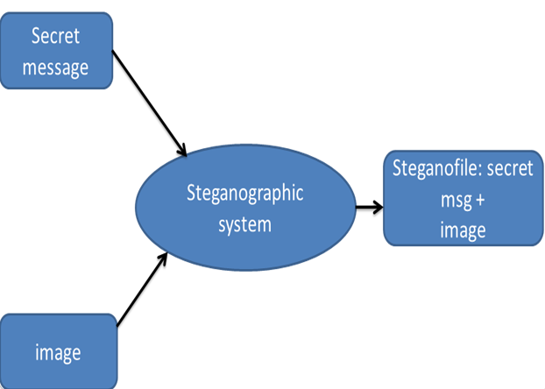
DATA FLOW DIAGRAM
Level -0

Slide 20
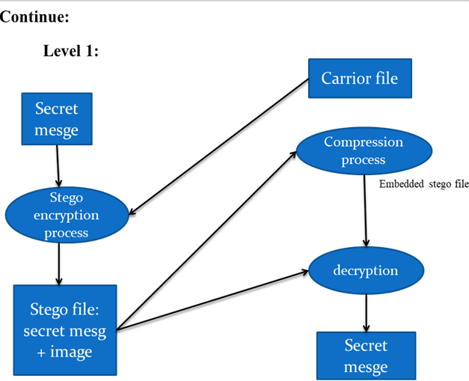

Slide 21
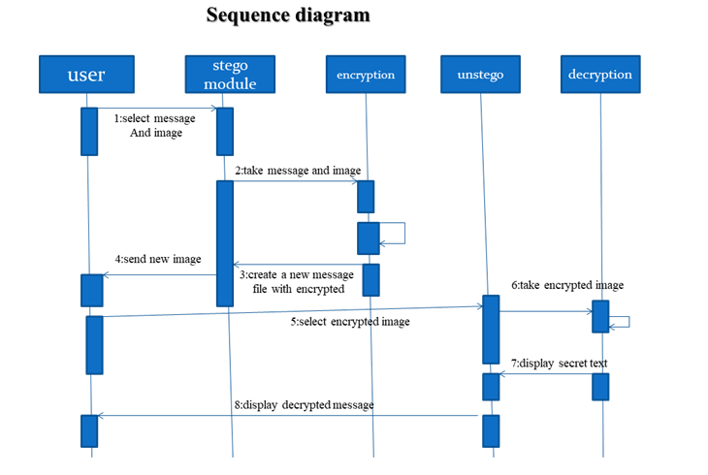
SEQUENCE DIAGRAM

Slide 22
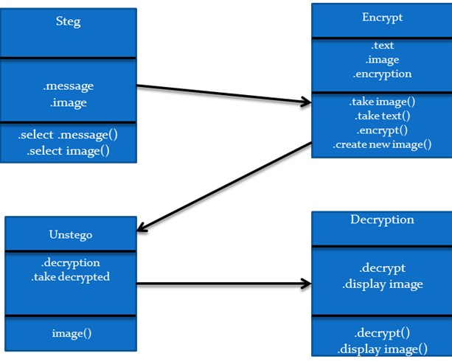
Class Diagram

Slide 23
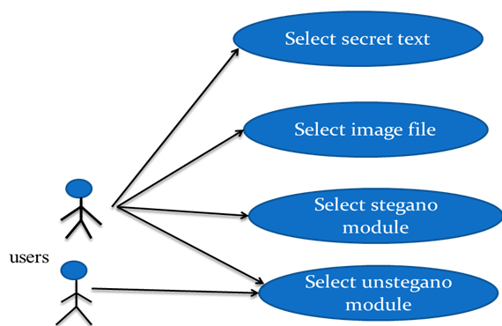
USE CASE DIAGRAM

Slide 24
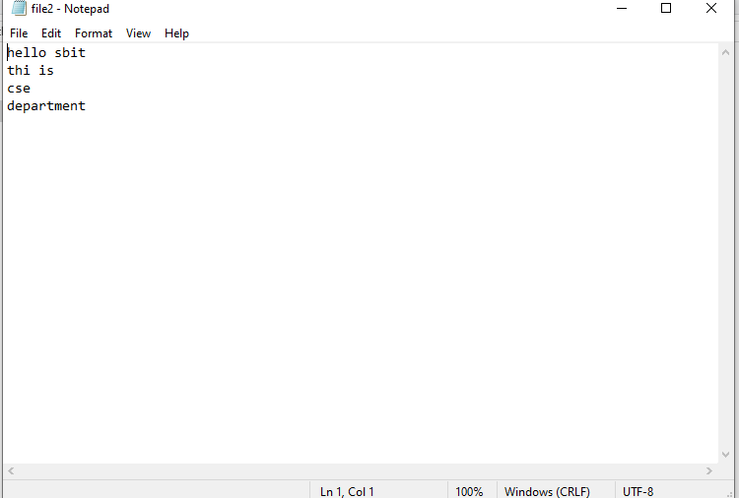
SCREENSHOTS
Secret Message Before Encode

Slide 25
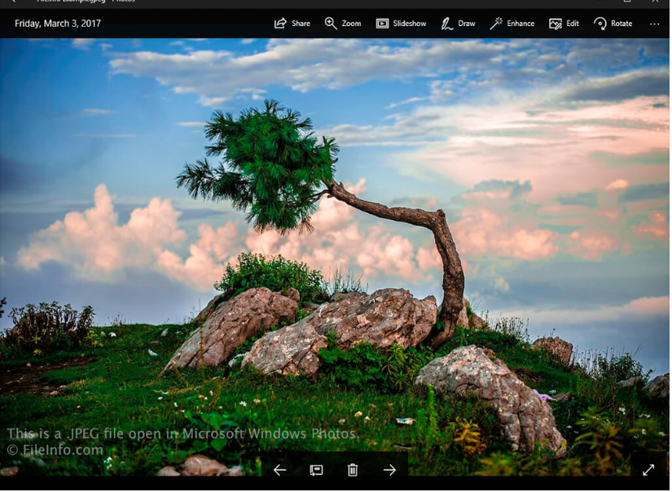
Cover Image

Slide 26
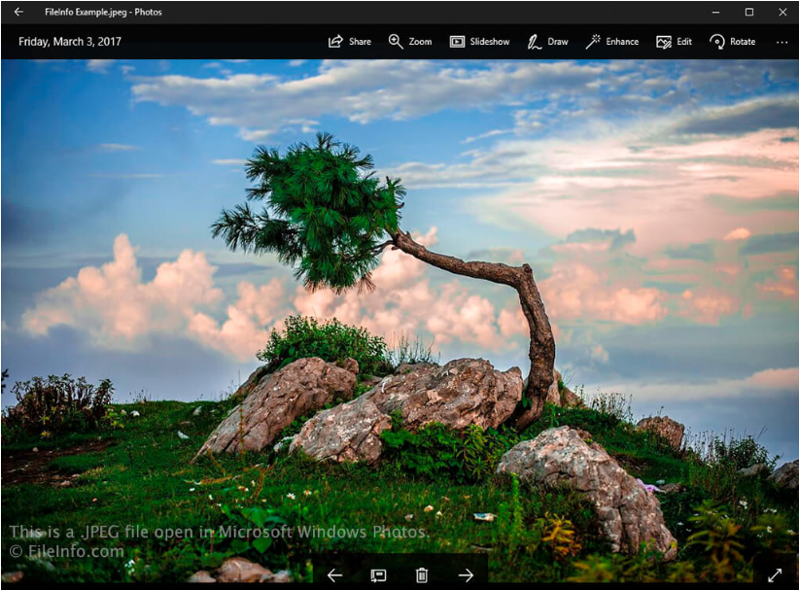
Stego Image

Slide 27
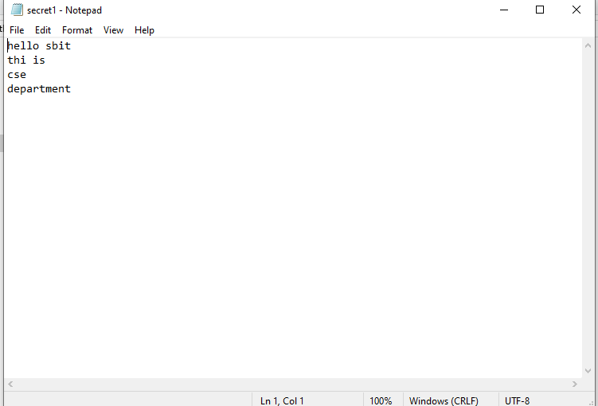
Secret Message After Decode

Slide 28
CONCLUSION
Steganography transmits secrets through apparently innocuous covers in an effort to conceal the existence of a secret and its derivatives are growing in use and application.
To hide confidential information steganography can be effectively used. The objective of any Steganographic method is to hide maximum secret information which is immune to external attacks and also should not convey the fact that the cover medium is carry secret information. This thesis has used LSB substitution technique for time domain and different transforms for frequency domain.

Slide 29
REFERENCE
[1] A Joseph Raphael and Dr. V Sundaram ,”Cryptography and Steganography – A Survey”
[2] Dr.R.Sridevi, Vijaya Lakshmi Paruchuri, K.S.SadaSiva Rao, Image Steganography combined with cryptography
[3] Mehdi Hussain, Mureed Hussain, “A Survey of Image Steganography Technique”
[4] Lokesh Kumar,”Novel security scheme for image steganography using cryptography

Slide 30
THANK YOU

